Slide 1

Identifying Vulnerabilities in VS Code Extensions : Supply Chain Attack
Team 6

Slide 2
Proposal
VS Code - popular text editor - 14 millions active users.
Supports various extensions to enhance functionality.
Pose security risks if not properly tested and validated.
Identify, analyze and test extensions of VS Code from a security breach point of view.
Suggest recommendations to mitigate the risks.
Not targeting typosquatting type of attacks.
Possible in VS Code

Slide 3
Inspiration
Immense user base makes it a significant target.
Third-party extensions
Challenging to guarantee no vulnerabilities.
Developer machines can contain important credentials
Critical parts of the codebase
Connect to production servers.
Extensions run with user privileges, without sandbox
Easy for malicious actors to install harmful programs.
Security experts warn about potential threats in the future
Crucial to scrutinize the legitimacy and security of VSCode extensions.

Slide 4
Phases
Phase 1: Extension Selection
Selecting extensions using official statistics, community feedback.
Phase 2: Vulnerability Identification
Analyzing selected extensions for potential security vulnerabilities.
Phase 3: Vulnerability Exploitation
Attempt to exploit identified vulnerabilities in selected extensions
Determine their potential impact
Validate mitigation strategies
Make remediation recommendations based on the findings.
Phase 4: Grouping Vulnerabilities & Automate Detection
Grouping extensions according to their underlying technology or coding practices.
Phase 5 : Reporting and Recommendations
Prepare a report that summarizes findings and recommendations.

Slide 5
Deliverables
List of the VS Code extensions.
A report detailing the security vulnerabilities in extensions.
A report detailing the results of vulnerability testing.
Group the vulnerabilities in categories.
Automate the process of vulnerability identification in the extensions of VS Code.
A set of recommendations for mitigating the identified vulnerabilities.
If possible, we will extend the project to include the extensions associated with other IDEs like IntelliJ and PyCharm.

Slide 6
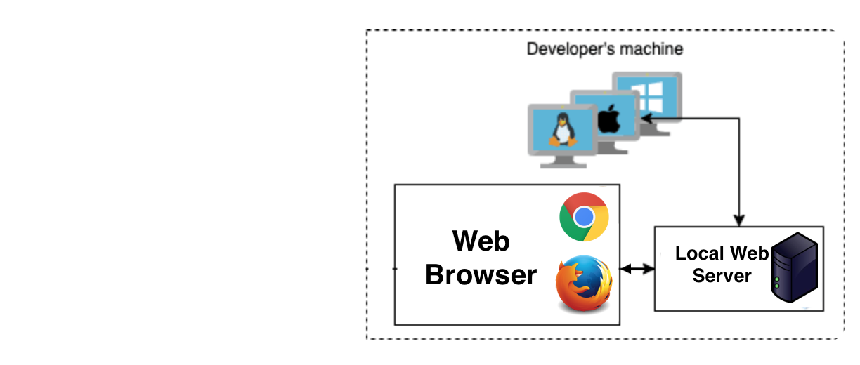
Progress : Initiation
Only a handful of articles.
Vulnerabilities in extensions creating a local server on the system.
Microsoft Live Preview¹ - Path Traversal Vulnerability
Microsoft SARIF Viewer¹ - Path Traversal Vulnerability
LaTex Workshop² - Code Execution
Open in Default Browser² - Path Traversal Vulnerability
Instant Markdown² - Path Traversal Vulnerability
Rainbow Fart² – Zip Slip Vulnerability
Decided to go for similar extensions to find path traversal vulnerability.
Challenge is to
Debug extensions.
Find a vulnerable extension.
Exploiting the extension.
Basic issue – Unsanitised inputs!!
[1] https://blog.trailofbits.com/2023/02/21/vscode-extension-escape-vulnerability/
[2] https://snyk.io/blog/visual-studio-code-extension-security-vulnerabilities-deep-dive/

Slide 7
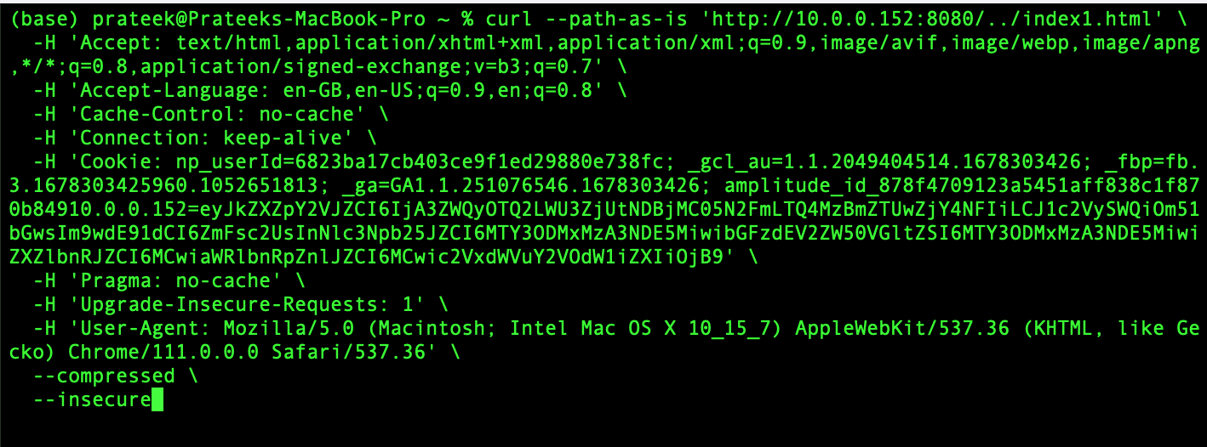
Progress : Finding a Vulnerable Extension
HQ Live Server³ - Path Traversal Vulnerability.
Index1.html outside the server’s root folder is served!!
[3] https://github.com/hqjs/vscode-hq-live-server

Slide 8
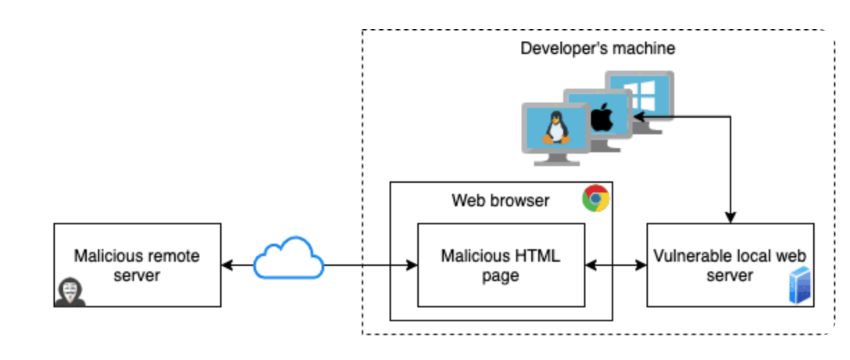
Progress : Exploitation Approach
Exploiting the vulnerability to access ~/.ssh/id_rsa.
Challenges:
Protection against XSS
Same Origin Policy
Run Malicious Webpage on developer’s Machine
Use running server with Path Traversal Vulnerability
Access ~/.ssh/id_rsa

Slide 9
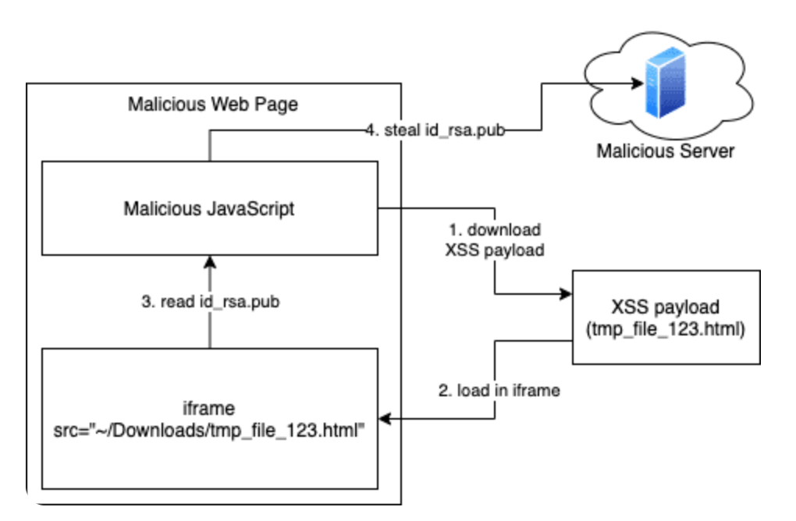
Progress : Overcoming the Challenge

Slide 10
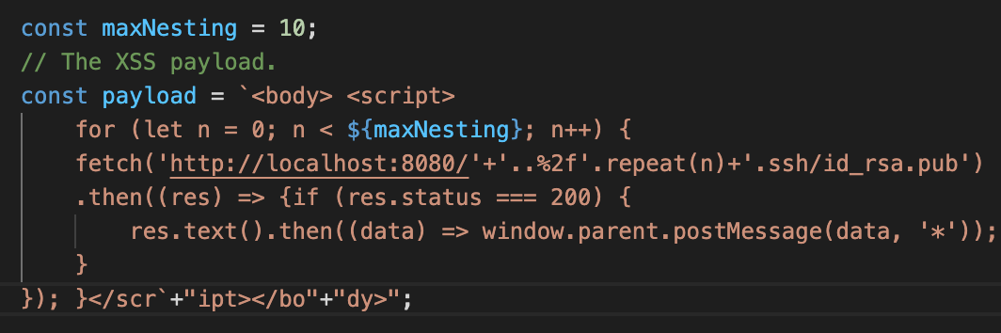
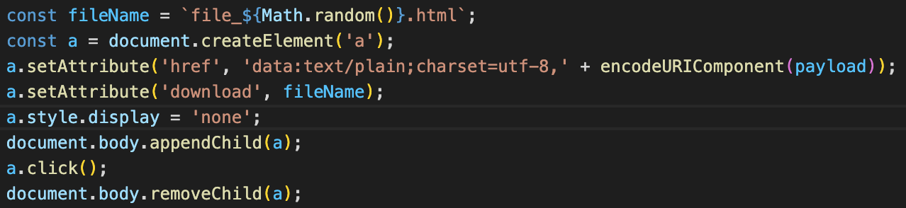
Progress : Exploiting the vulnerable Extension
Creating a Payload.
Download the payload on victim’s system.

Slide 11
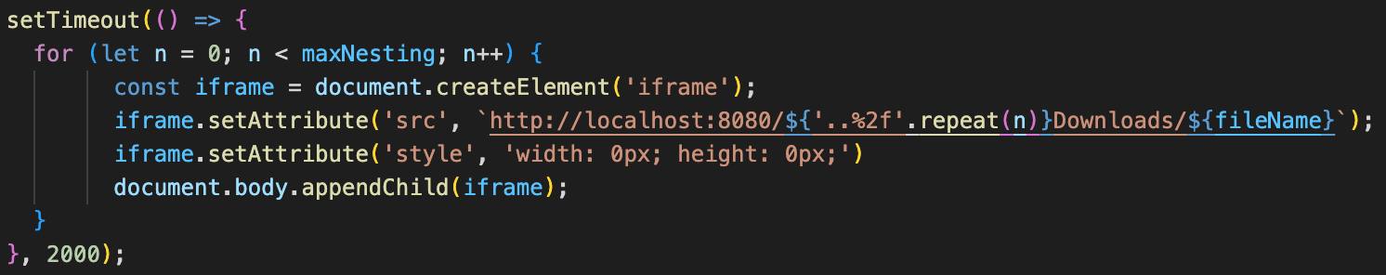
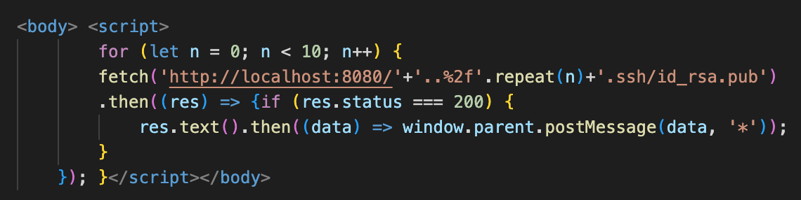
Progress : Exploiting the vulnerable Extension
Load the downloaded payload from victim’s system in an iframe in the browser.
Same Origin

Slide 12
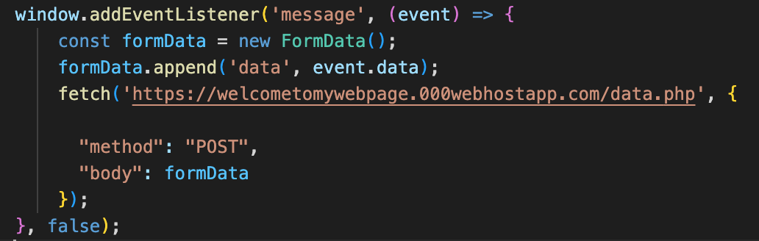
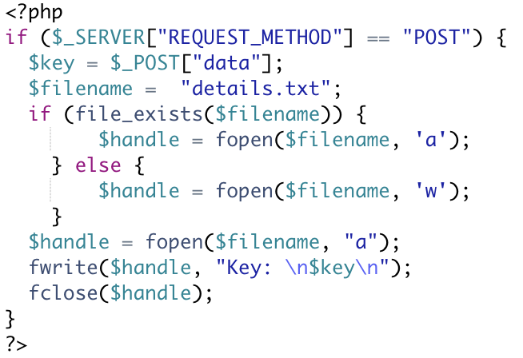
Progress : Exploiting the vulnerable Extension
Send the key to malicious server.
Server-side PHP code.

Slide 13
Demo of Exploitation
Open VS Code.
Activate the extension.
Click on the following link.
https://welcometomywebpage.000webhostapp.com/

Slide 14
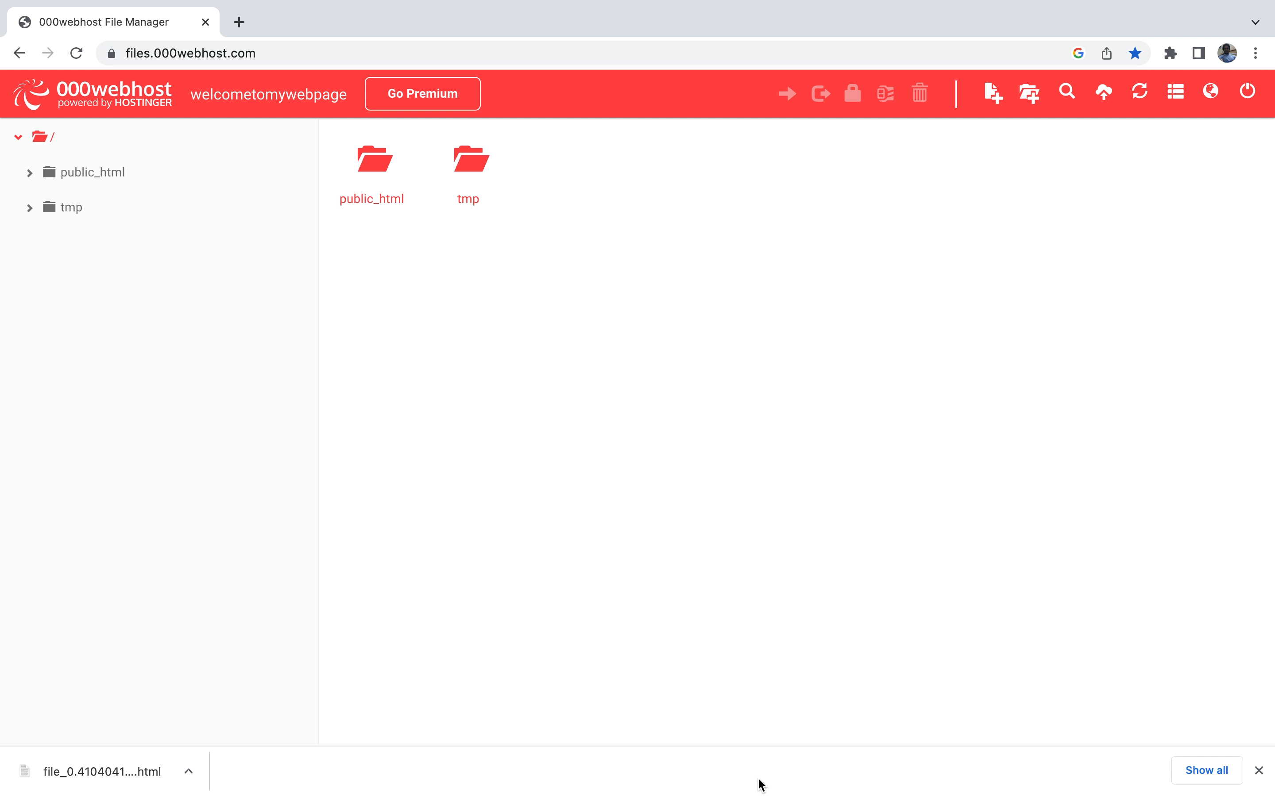
Demo Video

Slide 15
Way Ahead
Download the extensions in bulk.
VS Code does not provide any API to achieve this.
Innovative approach.
Use curl smartly inside a python script
Handle rate limiting
Automate vulnerability testing using available tools.
Unzip the extension.
Feed it to the automated tools to generate vulnerability report.
Package based (Snyk)
Code based (Semgrep)
Automate vulnerability testing using our findings.
Install the extensions.
Activate/run the extension.
Run test cases from our findings to identify the vulnerabilities.

Slide 16


